Slide 1


Speed You Up
Is a fully funded course (EU)
Support from business/stakeholders
Aimed at students that could become NEETS

Slide 2
…what is it about?
A coaching programme - ‘hands on’ learning style to suit at risk NEETS
Students are supported to set up a community orientated pop up’ through an enterprise Hub (in school) and develop entrepreneurship and employability skills
Gives the students responsibility, decision making skills and a ‘can do’ attitude

Slide 3
Speed You Up
…number of students
10/12 students (aged 15+) at risk of being NEETS
...duration of course
?? To be agreed with school

Slide 4
…with the purpose of
Increasing engagement
Raising aspirations
Improving life chances
Gaining entrepreneurial and employability skills

Slide 5
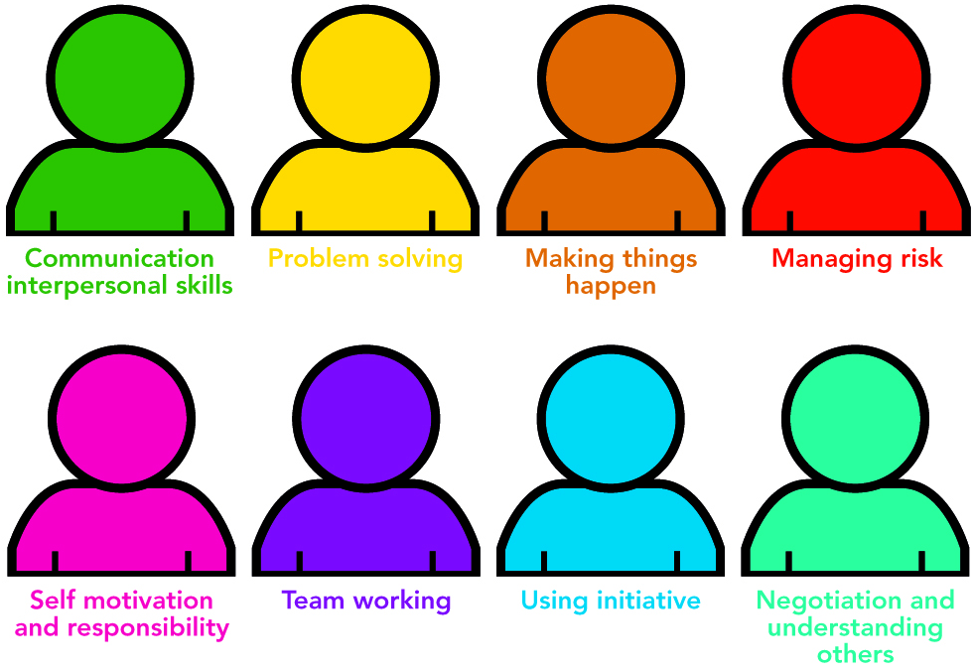
Employability skills

Slide 6
School benefits
Engaging programme for at risk NEETS
External adviser support
Employer link support
Fits the EU Entrecompe framework
UK - Meets the Gatsby 5 agenda that all schools have to adhere to.

Slide 7
?
How will we
support
your
School
Notes:
At a later date we will have a complete list of resources

Slide 8
Speed You Up programme:
Coaching programme provided
Teaching toolbox – materials etc
Support to implement the school based entrepreneur hub
Stakeholder support to help deliver the course - master class/talks
External advisor as support

Slide 9
?
Why
Speed You Up
Notes:
At a later date we will have a complete list of resources

Slide 10
Speed You Up will help potential NEETS feel engaged in their future...and the world
…and gain a positive voice

Slide 11
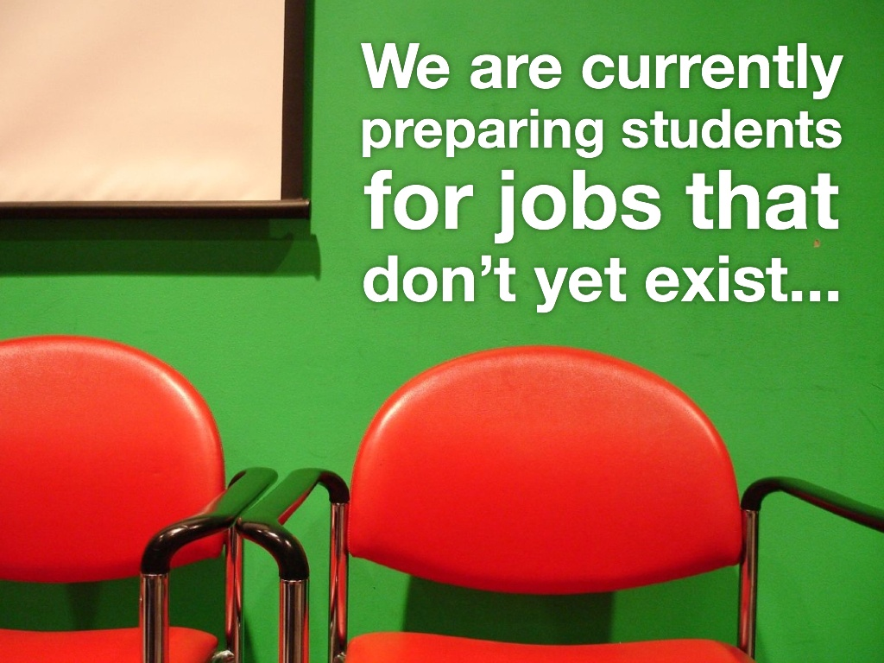

Slide 12

“New recruits
do not have the skills they need
to enter the world of work.”
Richard Lambert, Director-General of the employers' body, the CBI

Slide 13

Youth unemployment is high in NEETS

Slide 14
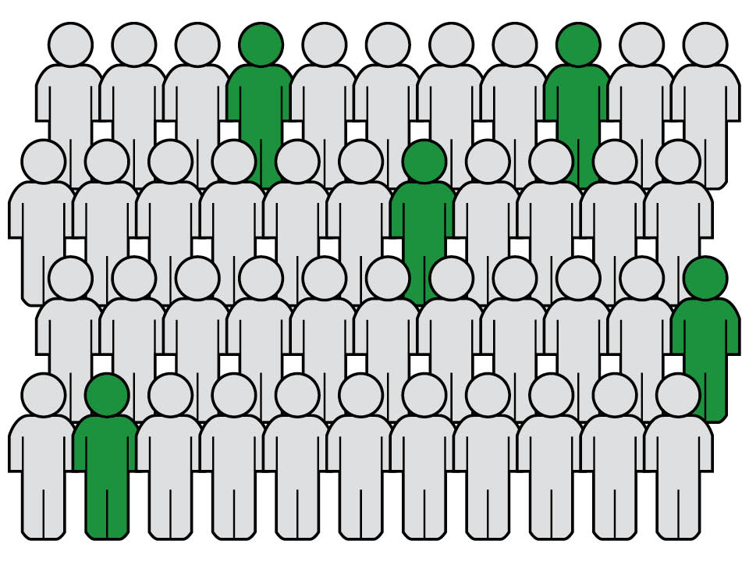
This course will help at risk NEETS stand out for the right reason
Notes:
Can you put 4 more DELP figures in picture – dotted about

Slide 15
As a pilot school of
Speed You Up
It could be life changing for at risk NEET students!
donna@devonmind.com
01752 512280
With thanks to DELP

