Slide 1


Introduction to
‘Speed You Up’
An EU funded project aimed at students that could become NEETS (acronym)
(students Not in Education, Employment or Training)

Slide 2

Business/stakeholder support required
(not financial)
To help young people who are at risk of failing and becoming a NEET
To offer your knowledge, support and skills through schools to support at risk students

Slide 3

Youth unemployment is high in NEETS

Slide 4
We need to help potential NEETS to feel engaged in their future...and the world
To gain employability skills!

Slide 5
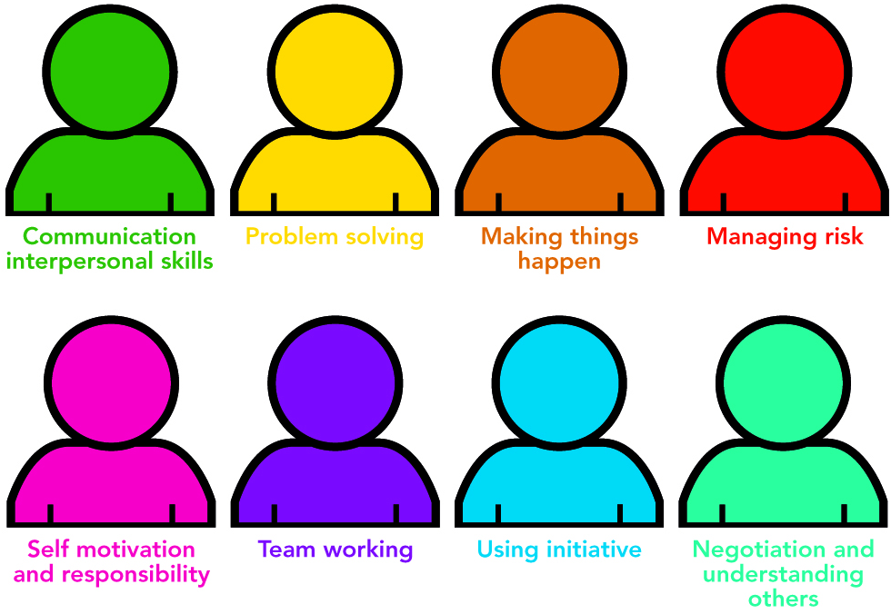
Enterprise/employability skills

Slide 6
?
What
specific help is needed from business?
Notes:
At a later date we will have a complete list of resources

Slide 7
Business support:
Collaborate with the school and other professionals from business, the community and welfare organisations to create a strong local network of engaged stakeholders to support students on the Speed You Up programme
Helps students on ‘specific’ parts of their learning experience through sharing your knowledge and skills

Slide 8
Speed You up project
project:
Help students gain knowledge about the world of work
Gives the students responsibility and help give them a positive voice
Help students develop entrepreneurship and employability skills

Slide 9
…and by doing so:
Raise their aspirations
Improve their life chances
Become financially independent
Help them understand how to start up their own business

Slide 10
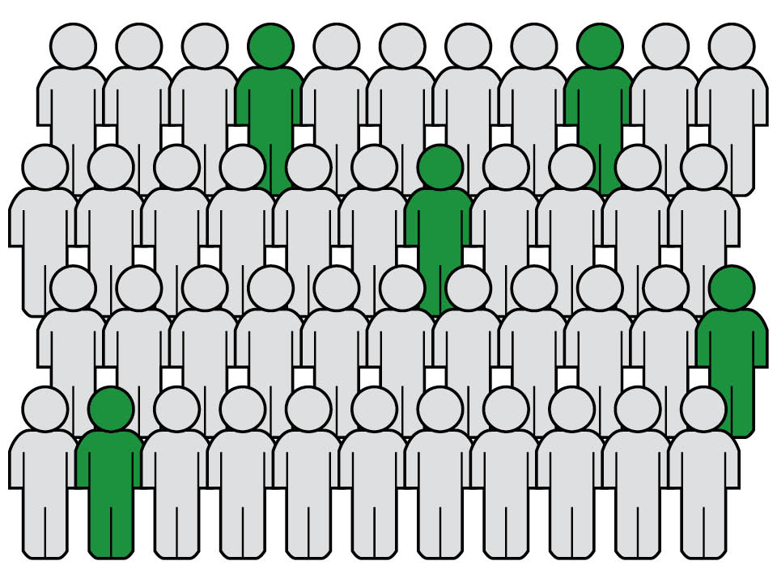
Help at risk NEETS stand out for the right reason
Notes:
Can you put 4 more DELP figures in picture – dotted about

Slide 11
Please support
Speed You Up
It could be life changing for students!
donna@devonmind.com
01752 512280
With thanks to DELP

