Slide 1



Community analysis
Notes:
An

Slide 2


What is a community analysis?
The goal of the community analysis is to collect information about the community.
It helps you to understand the people from the community, their needs and the environment they live in.

Slide 3

Why should you do a community analysis?
The framework we use is based on human centered design. The customer and his/her needs is the starting point to develop a business. Not the product itself. Doing a community analysis gives you insights on those needs prior to developing a business idea.
We want the SYU pop-ups to be community oriented. The pop-ups should contribute to making the community better.
It gives you an opportunity to grow: start locally, and then look for other communities with similar needs.
We want you to build a network: not only with residents, but also with other enterprises and organizations. Doing the community analysis will help you to do that.
If you start a pop-up, you can find your first customers in the proximity of your school. If that is not the case, doing a community analysis can still be beneficial: you can look for potential partners that could support your business for example.

Slide 4
Start with what you know
Doing a community analysis should provide you with knowledge of the community. If you want to start a pop-up, it is important that you understand the needs of the community and that you know which enterprises the community is lacking. Therefor, you will need to use different methods to engage the community.
But first: start with what you know!
Who do you think lives in the community? (Age, income, origin, …)
What do you like about the community, what are the strengths of the community? (Try to think of 3)
What don’t you like about the community, what are the weaknesses of the community? (Try to think of 3)

Slide 5

Make a map
(You can use Google maps or another tool)
Define your community: what do you think is ‘the community of the school’? Make a map and draw what you see as ‘the community’.
Why? Do you all agree?
What are the important roads and means of transportation?
What are the important places (churches, mosques, stores, organizations,…) in the community? Indicate those on the map.
What have you learned about the community by looking at the map?

Slide 6
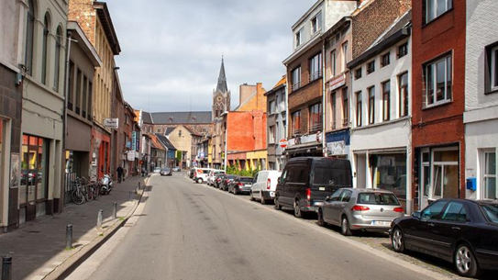
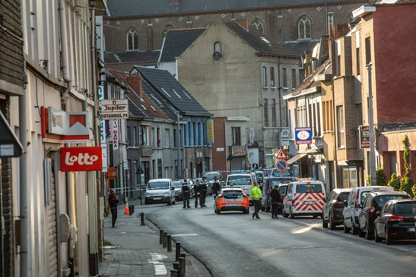
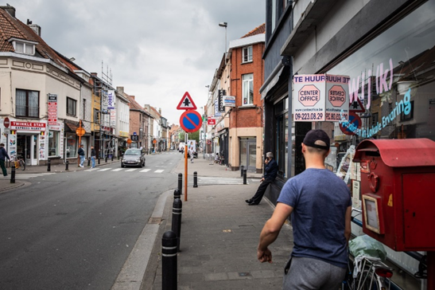
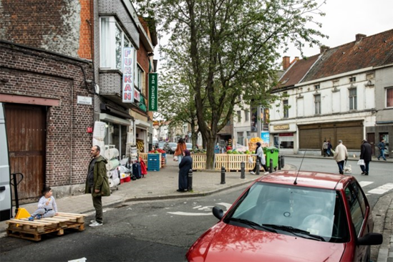
What can you learn by looking – example 1
To be adapted to regional context. Example applies for Ghent.

Slide 7
What can you learn by looking – example 1
Which things do you notice when looking at those pictures?
What do you like about this neighbourhood?
What do you dislike?
Who do you think lives in this neighbourhood? (age, origin, income, …)
What kind of houses do you see in this neighbourhood? What does that tell you about the neighbourhood?
What kind of business ideas could be interesting for this community? Try to think of at least 5 interesting ideas.

Slide 8
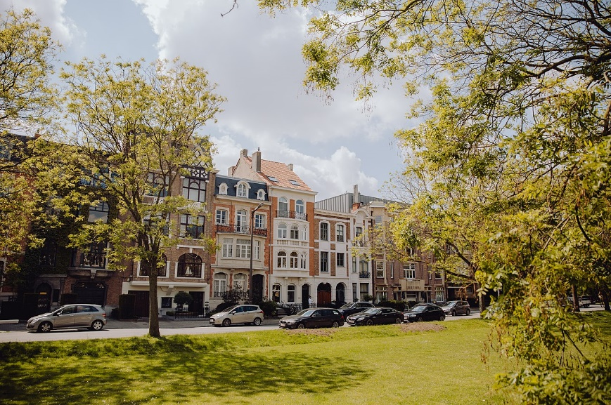
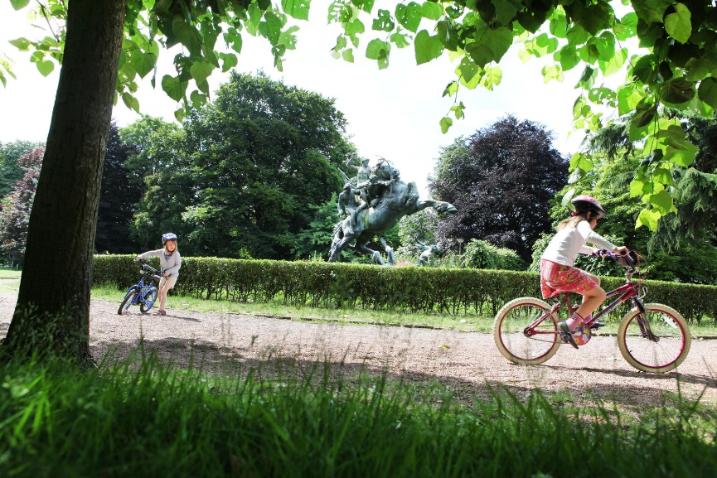
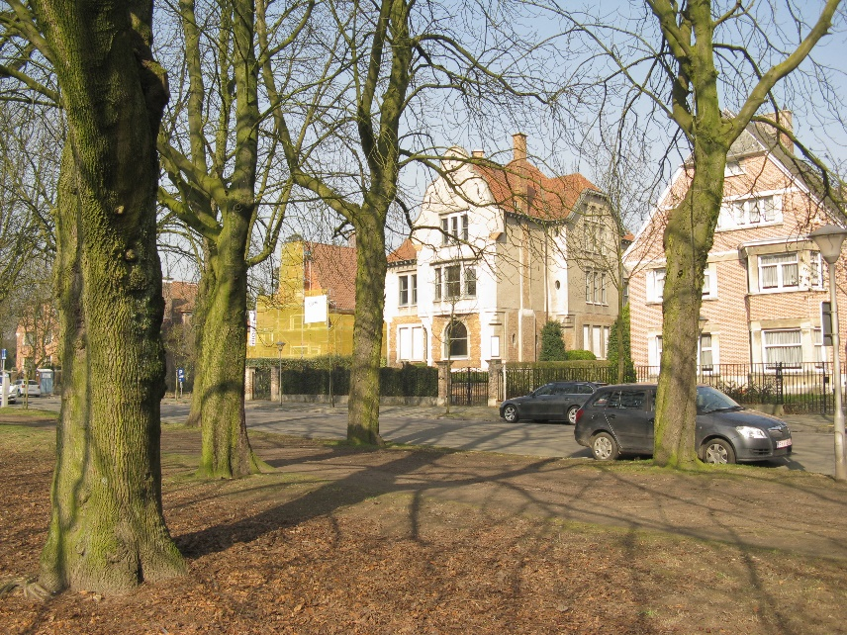
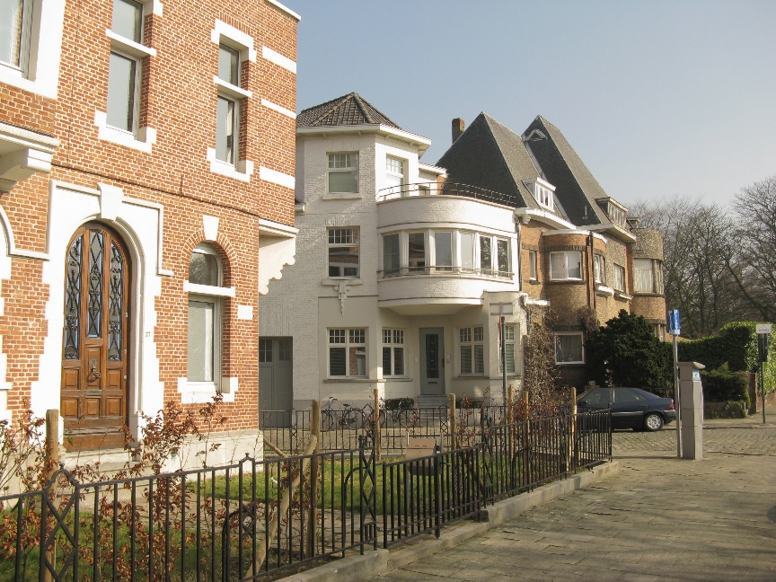
What can you learn by looking – example 2
To be adapted to regional context. Example applies for Ghent.

Slide 9
What can you learn by looking – example 2
Which things do you notice when looking at those pictures?
What do you like about this neighbourhood?
What do you dislike?
Who do you think lives in this neighbourhood? (age, origin, income, …)
What kind of houses do you see in this neighbourhood? What does that tell you about the neighbourhood?
What kind of business ideas could be interesting for this community? Try to think of at least 5 interesting ideas.

Slide 10

Inspiring example: let’s save food!
To be adapted by the schools: look for an initiative in the proximity of the school or an enterprise that speaks to the young people.
Example for Ghent: https://www.facebook.com/watch/?v=1250666091789256
What does Let’s Save Food do?
What are the different ways in which Let’s Save Food engages with the community?
What is the added value of doing a community analysis for Let’s Save Food?

Slide 11
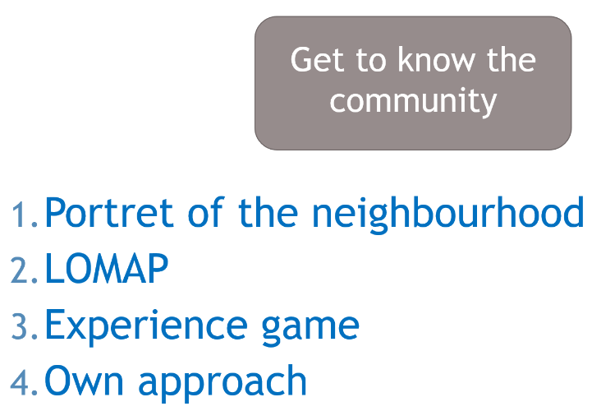
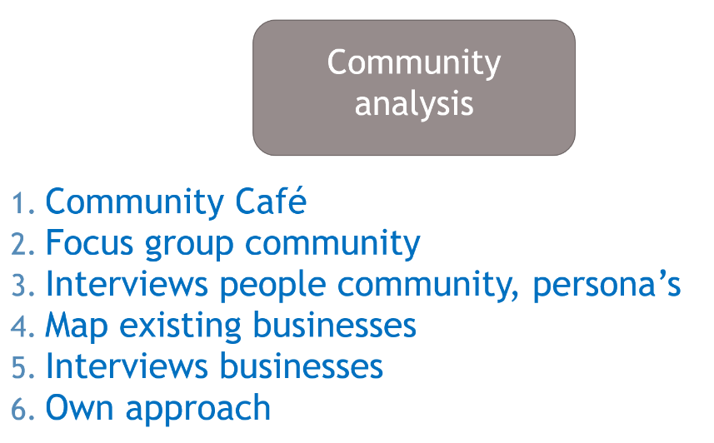
How can you do a community analysis?
You should make some choices in order to decide which method to use:
What kind of information do you want to collect about the community?
Do you need to talk to people to get that information or will you be able to find the information by yourself?
Who will be able to give you that information (residents, enterprises, organisations, etc)?
How can you find the information by yourself?
What questions are interesting to find an answer for in order to start a business?

